Slide 1
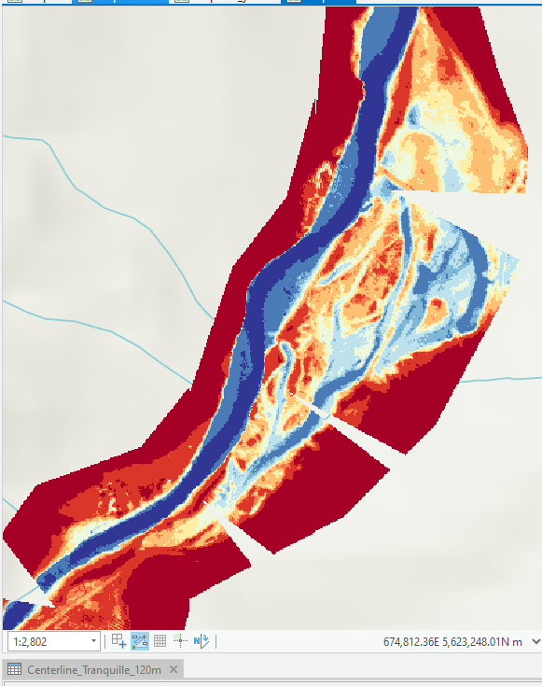
Geomorphic Grade Line Tool
Paula Soto
Paula.Soto@dfo-mpo.gc.ca
April 2024
DFO - RCOE
Notes:
Line spacing + Page numbers

Slide 2
What is the Geomorphic Grade Line tool?
The Geomorphic Grade Line (GGL) is a tool designed for use in Stage 0 restoration. It is aimed at restoring unconfined depositional valleys to their natural pre-disturbed state.
It involves identifying key geomorphic features and developing the GGL based on the valley's elevation data. The GGL represents the historic valley surface, crucial for restoration design.
This method enables the creation of a relative elevation model (REM) to aid in evaluation and design. The REM then guides the final grading plan for valley modification, ensuring alignment with natural features for restoration.

Slide 3
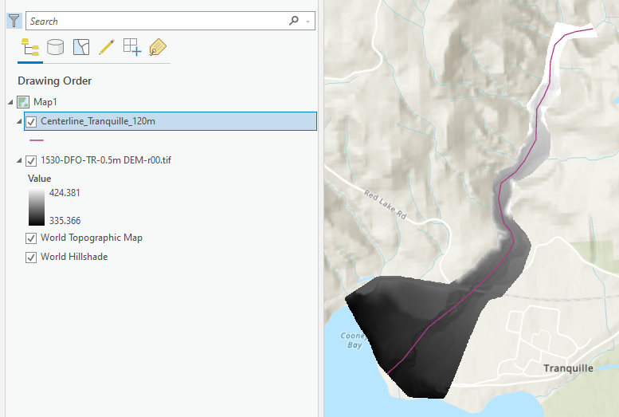
Step
01
Run the “Create a Centerline Feature Class” tool and draw a centerline on the DEM.

Slide 4
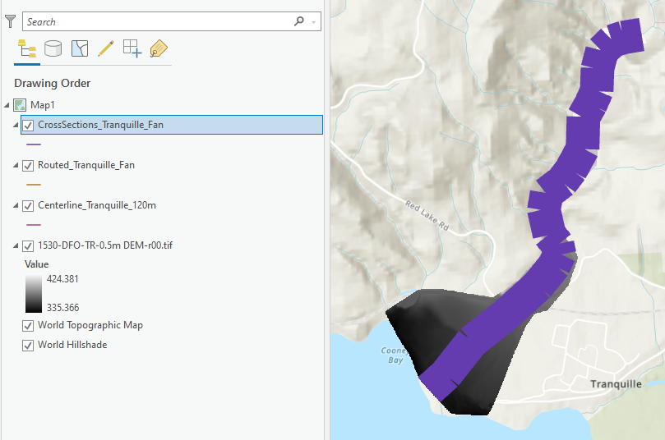
Step
02
Run the “Create Cross Sections and Routed Centerline” tool to produce cross sections across centerline (purple polylines)

Slide 5
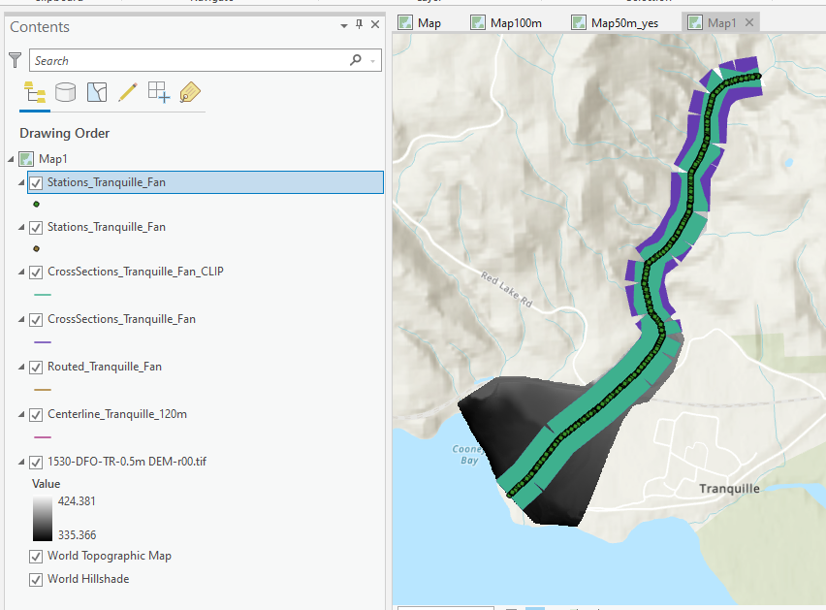
Step
03
Run the “Create GGL Table and Centerline Stations” tool to cut polylines to DEM, produce GGL Table with elevation data, and produce shapefile with the polyline’s centre stations (green poly lines and points).

Slide 6
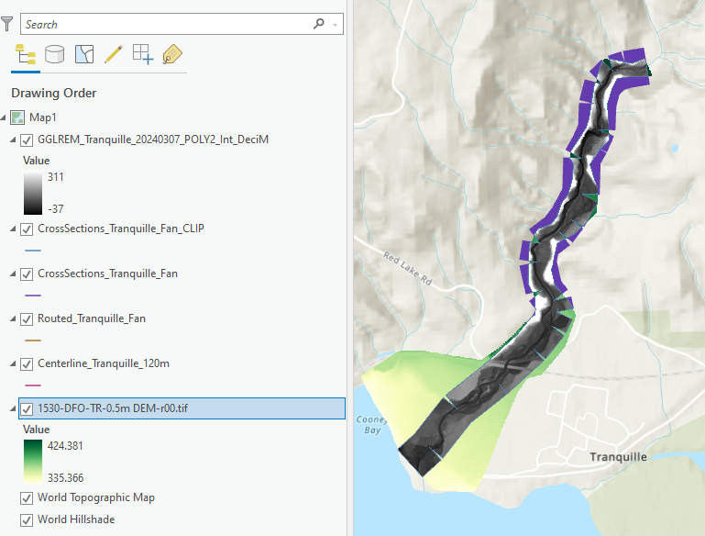
Step
04
Decide on model used to construct REM based off of the GGL Table output and then run “Create Relative Elevation Model(s)” tool. Output is in grey monochromatic colour scheme.

Slide 7
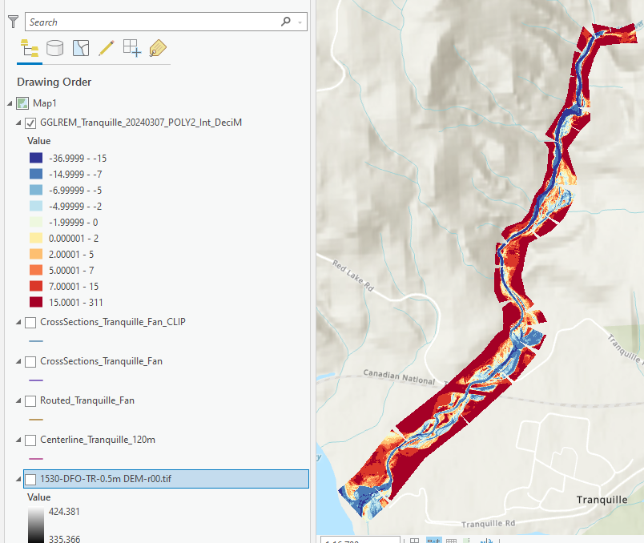
Step
05
Set the REM’s symbology to meaningful values and colours and then export as a georeferenced tiff for use in the field.

Slide 8
Final Step
07
08
Step
Iteratively refine the model as necessary.
Given the complexity of many models, it's unlikely to achieve optimal results in a single iteration. Relying on historical insights, field verification, and a deep understanding of the current system, iterate on the model to progressively enhance the accuracy of the resulting REM.
Develop grading plan for construction.
Validated REM can then be used to develop volumes and maps to preserve natural surfaces and modify high and low surfaces.

